Slide 1
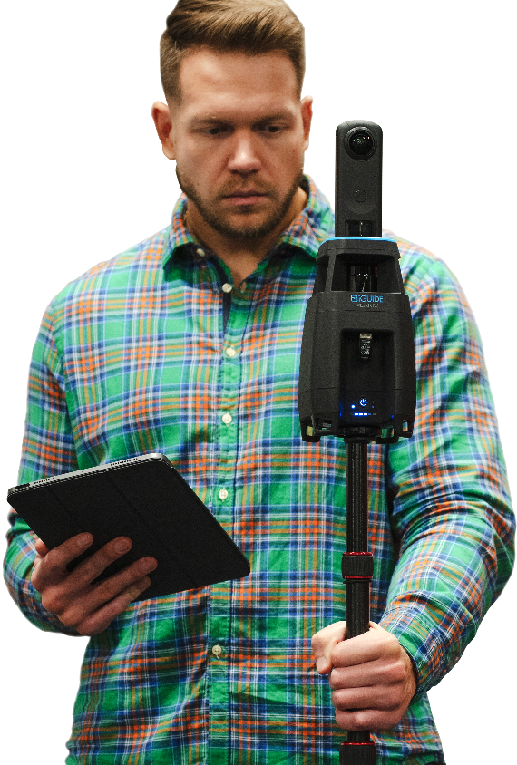
Precision meets innovation
Leaders in Building Measurement & As-Built Documentation

Slide 2
Supporting the life of your project
We deliver…
PRE-DESIGN
Existing Conditions
Reflected Ceiling Plans
Exterior Elevations
Precise measurements
Drawing packages
CONSTRUCTION
RADIX Tour
360° virtual walkthrough
Building and equipment photos and tags
OCCUPANCY
Site Survey
Marketing Package

Slide 3
Why iGUIDE for full site documentation
Enhanced Speed
Take site data collection from weeks to days.
Improved Accuracy
Ensure measurements and drawings are up-to-date and accurate.
Immersive Visuals
Provide your design team with 360° visualization of the space inside and out.
Streamlined Execution
Avoid return trips to site for missing and incorrect information.
Strengthened Collaboration
We ensure everyone on the project team is working from the same data set.

Slide 4
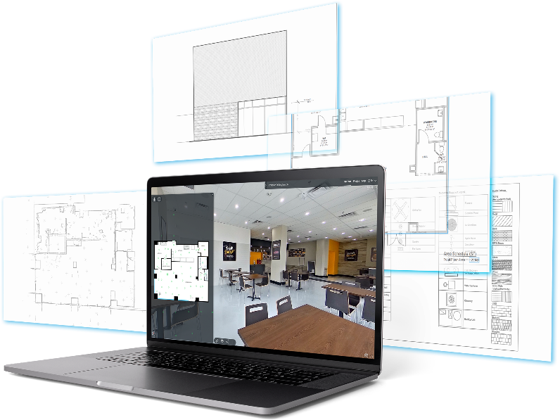
Full site documentation package in 3 easy steps
Comprehensive CAD Package
Kick-off
Tell us about your project (project purpose, desired elements, location) to get started.
Site Visit
Our local Field Technician will visit your site(s) to collect, scan and document the property.
Delivery
We’ll deliver your iGUIDE Report with downloadable drawing files, photos and links to your virtual walkthrough.

Slide 5
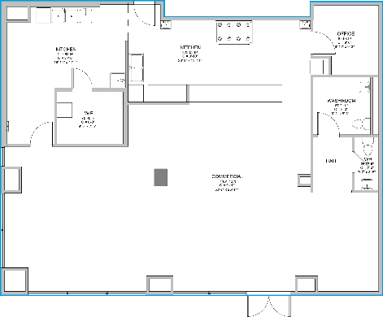
iGUIDE CAD Package
For comprehensive property understanding, each iGUIDE CAD package includes comprehensive property documentation.
As-Built Floor Plans
Dimension Plans
3D Virtual Walkthrough
Photo Tags of Building System Equipment Make, Model and Serial information
3D CAD Package includes: Exterior Elevation Drawings Roof Plan
Add-on available with 2D or 3D CAD Package: Reflected Ceiling Plans
EXPLORE SAMPLE PLOT PDF
CAD FILE
RVT FILE
3D
Walk
Through

Slide 6
CAD Package Drawing Details
As-Built Floor Plan (DWG & PDF) includes:
Architectural Items
Interior & Exterior Openings
Structural Columns
Stairs, Elevators, Lifts, Ramps, Int. / Ext. Roof Ladders
Roof Hatch
General Ceiling Heights & Features
Bathroom Privacy Partitions
Exterior Patios & Decks
Millwork
Appliances
Mechanical , Electrical & Plumbing Equipment
Plumbing Fixtures
Floor Drains
Water Meter
Hot Water Heaters
Sump Pits
HVAC Rooftop and Interior Equipment
Electrical Panels
Gas Meter & Hydro Meter
Generator
Exterior Elevation Drawings + Roof Plan (RVT, DWG & PDF) includes:
Architectural Items
Building Materials
Openings in Walls
Stairs & Ramps
Exterior Patios & Decks
Elevations will be created for each Customer Facing Wall
Reflected Ceiling Plan (DWG & PDF) Add-on includes:
Architectural Items
Bulkheads
Ceiling Types
Detailed Ceiling Heights & Features
Mechanical , Electrical & Plumbing Equipment
Exhaust
Supply and Return HVAC
Sprinkler Heads
Lighting

Slide 7
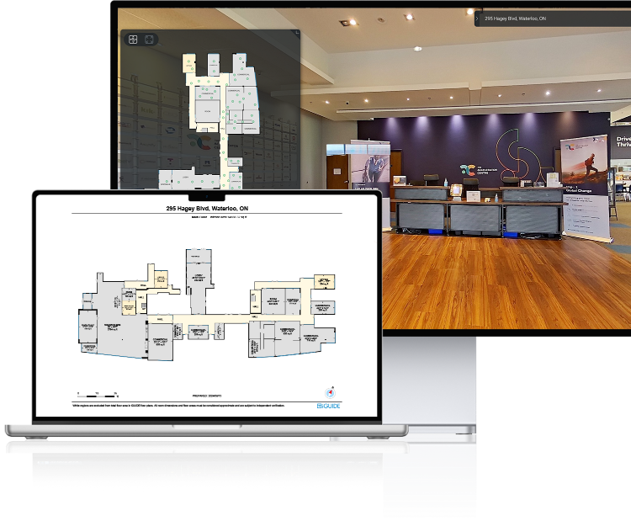
iGUIDE Premium
Provide an immersive virtual experience that lets colleagues, partners and contractors explore your site 24/7 from any location. What’s included…
3D Virtual walkthrough
Advanced on-screen measurements
Equipment photo tags (Make, model, serial numbers)
Detailed schematic floor plans with fixtures and appliances (PDF, JPG, SVG formats)
Room dimensions
Floor area calculations
Photo gallery & slide show
Downloadable offline file (self-hosting)

Slide 8
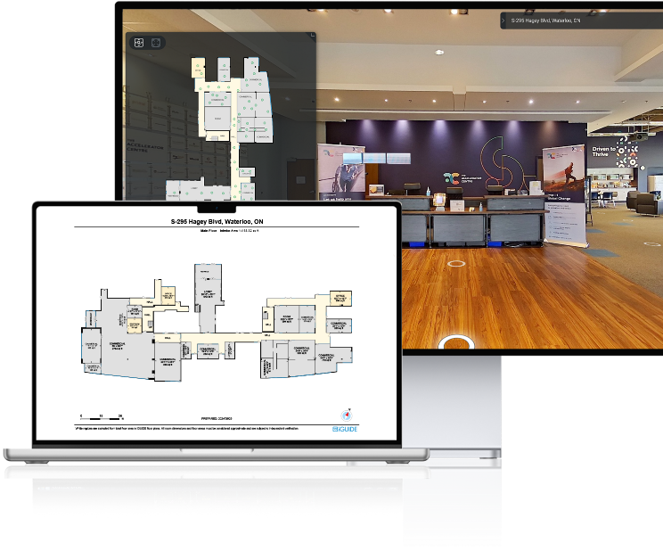
iGUIDE Standard
Provide an immersive virtual experience that lets colleagues, partners and contractors explore your site 24/7 from any location. What’s included…
3D Virtual walkthrough
Advanced on-screen measurements
Equipment photo tags (Make, model, serial numbers)
Schematic floor plans (PDF, JPG, SVG formats)
Room dimensions
Floor area calculations
Photo gallery & slide show
Downloadable offline file (self-hosting)

Slide 9
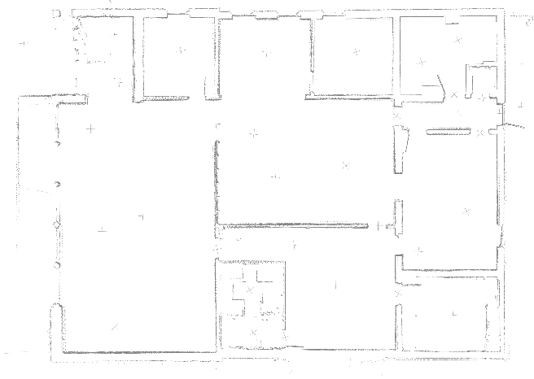
iGUIDE Radix
iGUIDE RADIX provides fast and efficient site visual documentation. The online interface with lidar point cloud is shareable and can be used to view a site and measure in 3D space. Deliverables include:
Lidar Point Cloud (DXF)
3D Virtual walkthrough
Advanced on-screen measurements
EXPLORE SAMPLE RADIX WALK THROUGH

Slide 10
Your project. Your data.
Data ownership
Rest assured you own the data from each of your projects.
No recurring fees
Pay for your project with no additional subscription fees attached.
Hosting flexibility
We can host your project at no cost or download and host yourself.
Data protection
Our information security program incorporates control principles from SOC 2.

Slide 11
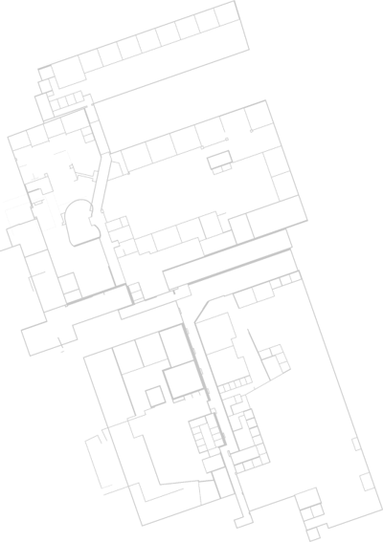
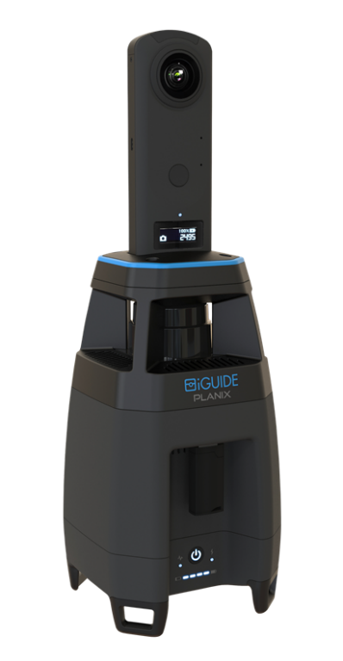
iGUIDE PLANIX Product Specifications
Lidar Measurements Range: Up to 40m (approx. 131’)
Lidar Measurement Uncertainty: +/- 1cm (approx. 0.4″) up to max range (typical, based on at least 60cm (approx. 23.6″) wide wall segment)
Lidar Field of View: 360 degrees
Type of Lidar: Time of flight
360° Camera: Ricoh THETA Z1
Output Resolution: 26 Megapixels
WIFI: 802.11 2.4GHz/5GHz Access Point
Software: Planitar web app in a web browser over Wi-Fi from any device
System Battery: 7.5V 6.9Ah/47.7Wh Li-Ion, user-replaceable
System Power Supply: Input – 100-240VAC, 50-60Hz, 1.0A; Output – 12VDC, 3.3A
System Battery Performance: 7 hours of typical operation
System Unit Weight: 980g (2.16lbs)
System Unit Dimensions: W: 11cm (4.3″) x D: 11cm (4.3″) x H: 34cm (13.4″)
Carrying Case Dimensions: W: 39cm (15.4″) x D: 29cm (11.2″) x H: 17cm (6.7″)
Tripod Mounting Thread: 1/4-20
Operating Temperature Range: 0-40 degrees C (32-104 degrees F)
Storage Temperature Range: -20-50 degrees C (-4-122 degrees F)
The iGUIDE PLANIX Camera captures 1000s of measurements with each scan

Slide 12
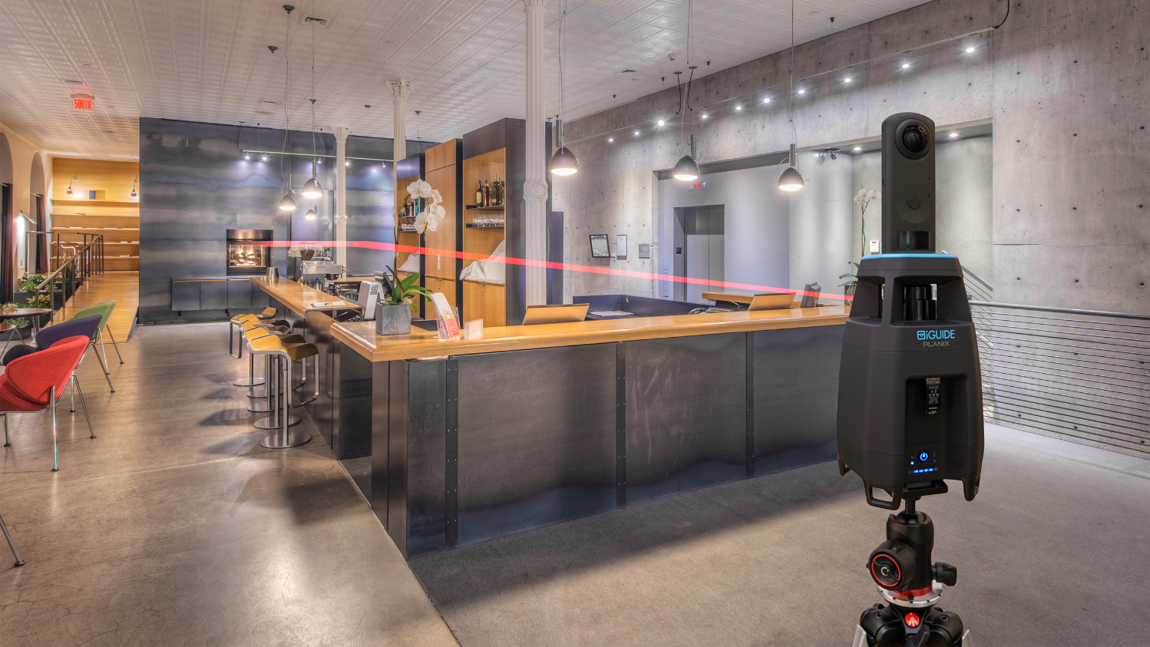
Let’s get started
Insert headshot
First Last Name
Company name
M. 123-456-4567
E. first.lastname@email.com

